Slide 1
ModuLoop
Team 28 PDR: Conor Curtin, Evan Rovelli, Ryan Gordon, Shawn Colby
Advisor: Baird Soules

Slide 2

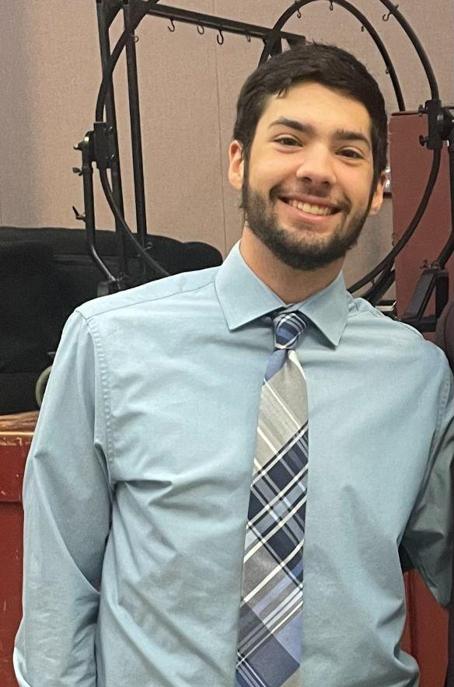


Meet the Team
Shawn Colby
Computer Engineering
Ryan Gordon
Electrical Engineering
Conor Curtin
Computer Engineering
Evan Rovelli
Computer Engineering

Slide 3
Problem Statement
Music creation has evolved over time and a lot of new technology has been incorporated into this process. There are many solutions designed to create backbeats and loops to aid musicians in creating music. However, a lot of these tools only have set features and are quite confusing for an inexperienced user to operate. We have decided to design a solution that is more modular in its features and easier for the user to operate. Our device will be able to have varying steps for each beat in a looping measure. There will be different sounds and effects that can be swapped by the user to achieve various styles of music. The loops will be chainable, so multiple measures of music can be made.
Notes:
Ryan
Look at use of modular?

Slide 4

Goal
We aim to develop a music sequencer that can use custom imported sounds along with sounds from a MIDI library to provide a user friendly, handheld platform used as a creative tool early in the production process of making music.
Notes:
Shawn

Slide 5
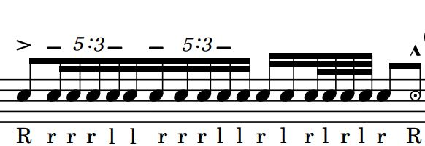
Terminology
Step - Moment in time when sound is output
Beat - Combination of one or more steps of equal length in succession
Measure - A collection of one or more beats in succession
Loop - A collection of one or more measures that is repeated
Tempo - The frequency at which beats occur in beats per minute (BPM)
Notes:
Conor

Slide 6
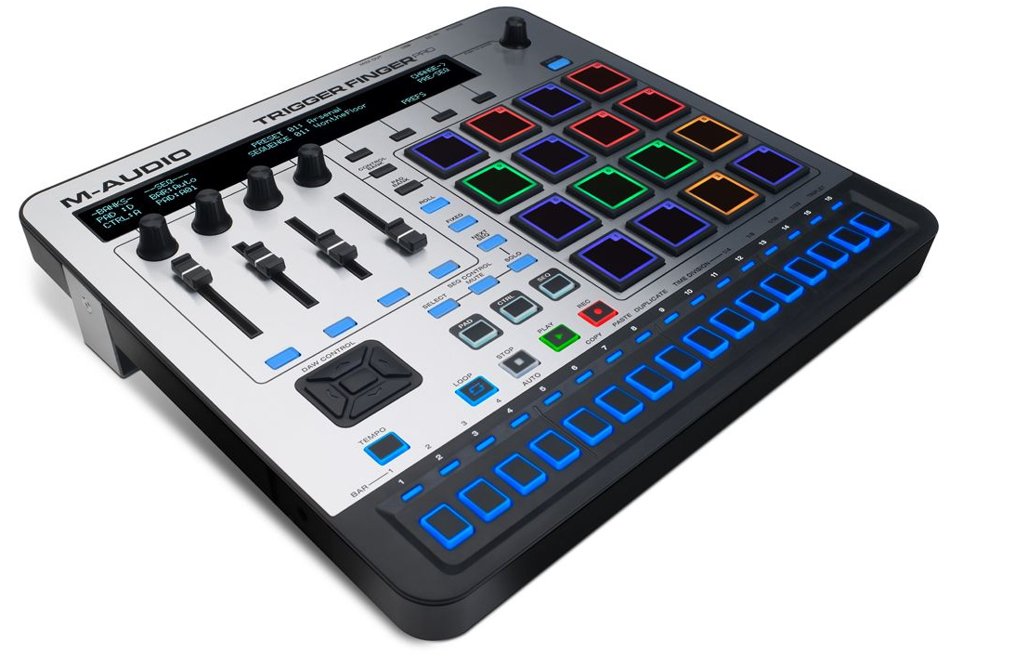
Basics of a Sequencer
Device that allows user to program sequences of sounds and effects
Multiple sounds can be layered on one step to create a more musical loop
Effects can be applied to individual
steps to alter the output
Notes:
Conor

Slide 7
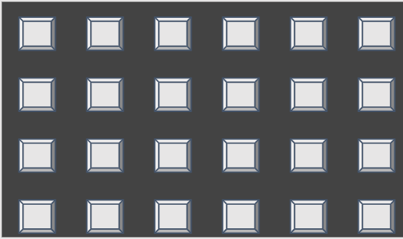
Explanation of Measure Matrix
In this example, six steps in succession create a beat
Four beats are played back to back to at a specific tempo create a measure.
Once the last step is played the system goes back to the first step creating a loop
Step
Beat
Measure
Notes:
Ryan

Slide 8
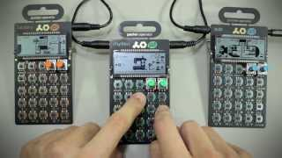
Demo of Pocket Operator Sequencer
Notes:
Ryan

Slide 9
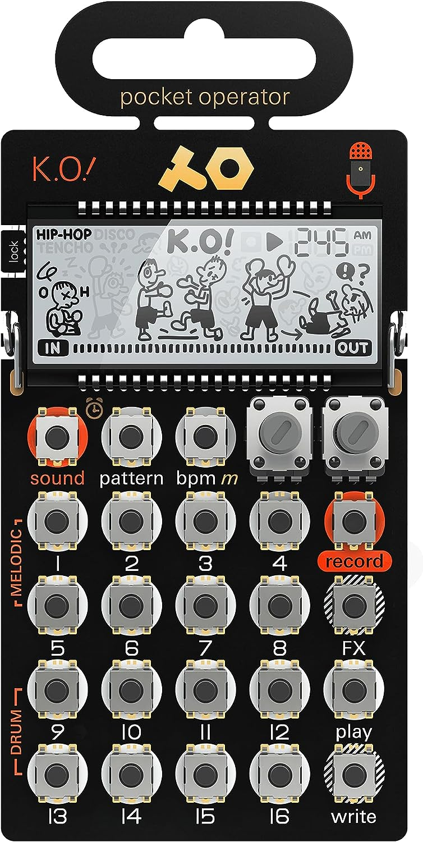
Existing Solutions
$99.99 Pocket Operator KO! By Teenage Engineering
Type: Micro sampler & sequencer
Sequencer: 16 step sequencer
I/O: 2x 3.5mm connector, LCD screen
Sounds: 16x (8 melodic sample & 8 drum slots)
Effects: 16x (Octave up & down, stutter, quantize,...)
Speaker: Built-in
Power Source: 2x AAA Batteries
Size: 1.2 x 2.4 x 4.9 Inches
Weight: 0.2 LB
Notes:
Evan
https://teenage.engineering/guides/po-33/en
Static sound library - cannot be changed - requires chaining devices
3.5mm connections used for headphones or chainning
Includes built in speakers
Minimal SBC construction
Very portable
Is battery powered by consumable batteries
Is very light weight
PO-33
micro
Sampler
battery information:
install only new batteries of the same type.
failure to insert batteries in the correct polarity, as indicated in the battery compartment, may shorten the life of the batteries or cause batteries to leak.
do not mix old and new batteries.
do not mix alkaline, standard (carbon-zink) or rechargeable (nickel cadmium) or (nickel metal hybride) batteries.
do not dispose of batteries in fire.
batteries should be recycled or disposed of as per state and local guidelines.
fcc statement:
note: this equipment has been tested and found to comply with the limits for a class b digital device,
pursuant to part 15 of the fcc rules. these limits are designed to provide reasonable protection against harmful interference in a residential installation. this equipment generates, uses and can radiate radio frequency energy and, if not installed and used in accordance with the instructions, may cause harmful interference to radio communications. however, there is no guarantee that interference will not occur in a particular installation.;
if this equipment does cause harmful interference to radio or television reception, which can be determined by turning the equipment off and on, the user is encouraged to try to correct the interference by one or more of the following measures;
reorient or relocate the receiving antenna
increase the separation between the equipment and receiver
connect the equipment into an outlet on a circuit different from that to which the receiver is connected.
consult the dealer or an experienced radio/tv technician for help.
this device complies with part 15 of the fcc rules.
operation is subject to the following conditions;
this device may not cause harmful interference, and
this device must accept any interference received, including interference that may cause undesired operation.
caution: changes or modifications not expressly approved by the party responsible for compliance could void user’s authority to operate the equipment.
ices statement
can ices-003 (b) / nmb-3 (b)
teenage engineering warrants that this product will be free from defects in material or workmanship for a period of 12 months from the date of teenage engineering’s shipment of the product to you, the customer. in the event of a defect covered by this limited warranty, teenage engineering will, at its option and free of charge to customer, repair, replace or refund the purchase price paid.
TEENAGE ENGINEERING MAKES NO OTHER EXPRESS WARRANTIES EXCEPT AS PROVIDED HEREIN, AND ANY AND ALL IMPLIED WARRANTIES OF MERCHANTABILITY OR FITNESS FOR PARTICULAR PURPOSE SHALL ONLY BE IN EFFECT DURING THE 12 MONTH WARRANTY PERIOD PROVIDED HEREUNDER. TEENAGE ENGINEERING'S LIABILITY ON ANY WARRANTY CLAIM SHALL BE LIMITED TO THE ACTUAL PURCHASE PRICE PAID. TEENAGE ENGINEERING SHALL NOT BE RESPONSIBLE TO CUSTOMER OR ANY THIRD PARTY FOR ANY CONSEQUENTIAL, INCIDENTAL OR INDIRECT DAMAGES, INCLUDING BUT NOT LIMITED TO LOSS OF PROFITS, LOSS OF DATA, REVENUES, SALES, BUSINESS, GOODWILL OR USE.
what does this limited warranty not cover?
teenage engineering has no obligation to repair, replace, or provide refunds in the following instances:
if the alleged defect arises because customer has altered or repaired the product without the prior written consent or authorization of teenage engineering;
if customer did not follow any applicable instructions for proper storage, usage, or maintenance of this product;
if customer has failed to notify teenage engineering of any defect where the defect should have been reasonably apparent on inspection; or
if customer fails to notify teenage engineering of the defect within 12 months of teenage engineering's shipment of this product to customer. this limited warranty does not cover the cost of shipping the defective product to teenage engineering for repair, or the cost of shipping the repaired or replacement product to you. how do customers receive warranty service? please call your teenage engineering customer service representative for details on how to raise an issue in relation to your product.
play / rec mode
break away hanger
built-in microphone
time /
additional info
folding stand
knob A / B
record
effects
play / stop
write
indicates write
mode is active
selected
tempo
lock tab
sound
to select sound hold
sound and press 1-16
alarm
to select pattern hold
pattern and press 1-16
pattern
press to select tempo
hold to set master volume 1-16
hold step 1-16 + m
to set multiplier
to use effects hold FX
and press 1-16
bpm
sound 1-16
pattern 1-16
effects 1-16
effect 1-16
1. loop 16
2. loop 12
3. loop short
4. loop shorter
5. unison
6. unison low
7. octave up
8. octave down
9. stutter 4
10. stutter 3
11. scratch
12. scratch fast
13. 6 / 8 quantize
14. retrigger pattern
15. reverse
16. no effect
auto power off (a.p.o)
the unit auto powers off when no buttons are pressed for a while, only powering
the display to show time.
press sound + bpm to show battery status.
factory reset
hold pattern + write while inserting batteries to restore the unit to factory default.
lock tab
break off the lock tab to freeze all patterns. to reverse, solder the two pads by the lock tab together. to restore to locked settings, remove the batteries. when lock tab has been removed sampling is no longer possible.
1 – getting started
power up
set clock
alarm clock
reset clock
insert two fresh AAA batteries. pay attention to plus and minus poles.
set time by turning knob A for hours and knob B for minutes. press any key to confirm and exit.
press sound + pattern. set alarm clock by turning A for hours and B for minutes. (disable alarm by turning knob A all the way down.)
press any key 1-16 to set pattern for the alarm. to stop the alarm press any key.
reset the clock by removing the batteries and start over.
2 – recording
record with microphone
record via line in
1-16
device
hold record + any key from 1-16. the microphone will record until the keys are released, and the recording will be stored in the position you selected (1-16). PO-33 has a total of 40 seconds recording memory. while recording, the number of seconds left will be displayed on the LCD. if the memory is full, delete or record over an existing sound.
if a cable is inserted into the line in jack, the PO-33 will record via line in.
3 – melodic and drum
PO-33 has 16 sound slots divided into two sections; melodic and drum. a sound will behave differently depending on which section it was recorded to.
in the melodic section the keys from 1-16 represents a scale, and each key will trigger the whole sound.
in the drum section each key from 1-16 represents a slice of the sound.
4 – playing
select sound
write
sound
1-16
write
select a sound by holding the sound key and pressing any key from 1-16. press any key from 1-16 to play. if nothing is heard, press write key once.
to enter/exit write mode, press write. press 1-16 to enter sounds/notes in the grid. active steps will be lit. press lit steps to remove them. press play to listen to your pattern.
5 – playing a pattern
select pattern
play
sequencer
pattern
1-16
play
hold pattern and press any key from 1-16 to select pattern. blinking led indicates active pattern.
press play to listen to your pattern. press play again to stop.
a pattern consists of 16 steps.
6 – tweak the sound
parameters
trim
FX
B
A
TONE: pitch and volume
FILTER: high-/low-pass filter
and resonance
TRIM: start point and
length of sound
press FX to toggle between the different parameters.
PO-33 has a total of six adjustable parameters. all parameters are adjusted using the two knobs, A and B.
in trim mode turn A to set the start of the sound, turn B to set the length of the sound. in the drum section each slice can be adjusted individually. the last triggered slice will be adjusted.
delete sound
copy sound
copy slice
hold record and press sound to delete the currently selected sound.
hold write + sound and press any key 1-16 to copy the selected sound to that position.
to copy the last triggered slice from one drum sound to another; hold write + sound and press any drum key 9-16 and then any key 1-16.
adding effects
swing
tempo
while playing, hold FX and press any key from 1-15. if write mode is enabled, the effects will be saved in the pattern. to clear the saved
effects, make sure write mode is enabled while holding FX + key 16.
hold bpm and turn A to adjust the swing.
press bpm to switch tempo. the bpm will be displayed in the upper right corner of the screen.
HIP HOP (80 bpm)
DISCO (120 bpm)
TENCHO (140 bpm)
hold bpm and turn B to fine-tune tempo (from 60 to 240 bpm).
volume
live record
parameter locking
hold bpm and press any key 1-16 to adjust master volume. note: be careful with the volume setting when using headphones. only exceed volume setting 5 with caution.
while playing, hold write and press any key 1-16 to punch in notes. notes will be quantized along with current swing setting. release write when finished.
while playing a pattern, hold write and turn knob A and knob B to lock the currently selected parameters. the parameters will affect the currently selected sound. lockable parameters:
- tone
- filter
7 – making a song (pattern chaining)
chain pattern
copy pattern
clear pattern
pattern
1-16
press and hold pattern and select which patterns 1-16 to chain by pressing the corresponding key 1-16. up to 128 patterns can be chained.
one pattern can be selected multiple times.
example: 1,1,1,4 plays pattern 1 three times then moves on to pattern 4. after the last pattern is played the sequence will start over again.
hold write + pattern and press 1-16 to paste the active pattern to the corresponding new slot.
press record + pattern to clear the active pattern.
8 – data
direct transfer
receive data
transmit data
transmit receive
it is possible to transfer sound and pattern data directly between units, using the line out / line in connectors.
insert a 3.5mm stereo cable from the transferring unit line out to receiving unit line in.
on the receiving unit press and hold write + sound + record to enter receive mode.
note: all samples and patterns on the receiving unit will be erased once the transfer starts.
before transmitting make sure the receiving unit is in receive mode.
on the transmitting unit: press write + sound + play to transmit data to receiving unit.
backup data
restore data
device
record
device
play
sound and pattern data can be stored to any stereo recording device for saving and sharing. connect a 3.5mm stereo cable from the transferring unit line out to the recording device line in.
start recording on the device and then press write + sound + play to transmit data.
to restore data back to the pocket operator connect the device line out with a 3.5mm stereo cable to pocket operator line in.
press write + sound + record to enter receive mode and then press play on the device to send data.
note: when restoring data to a pocket operator all samples and patterns on the receiving unit will be erased once the transfer starts.
to verify that all data was saved and restored correctly you may want to use a secondary PO-33 unit for verification to avoid erasing the original content.
9 – sync multiple units
sync
sync modes
input
output
master
SY1
SY4
sync
ID input output
SY0 stereo stereo
SY1 stereo mono/sync
SY2 sync stereo
SY3 sync mono/sync
SY4 mono/sync stereo
SY5 mono/sync mono/sync
it is possible to sync
multiple pocket operators with a click track using line in and out.
warning: sync levels should not exceed 5vpp (volt peak-to-peak).
connect a standard stereo audio cable between the units. the master unit will control the tempo of the sync unit.
hold record and press bpm on master unit to toggle sync modes. press repeatedly to toggle between different modes displayed in the upper right corner of the screen. press play on sync unit to wait for master clock sync. press play on master to start.
there are 5 sync modes. default mode is SY0.
when sync is used the signal will be split between audio (right) and sync (left).
sync scenarios
SY1
SY5
SY4
master
sync
sync
external
device
SY2
master
sync
example A: sync three pocket operator units.
chain: PO-12 > PO-24 > PO-33
example B: sync external device such as volca, iPhone, computer or synckontrol to PO-33.
external
SY3
SY4
device
master
sync
sync
SY1
device
external
sync
audio
master
sync
example C: sync an external device to two pocket operator units.
example D: sync PO-33 to an external device.
mount the pro case (optional)
make sure
the folding stand
is also removed.
break away
hanger
don't have
a pro case?
buy here.
to mount the pro case to a pocket operator,
first you need to break away the hanger and remove
the folding stand.
wrap the pro case around the edges of the unit. make sure the edges of the case is tightly fit.
newsletter stores privacy terms and conditions press contact
©2023 teenage engineering

Slide 10
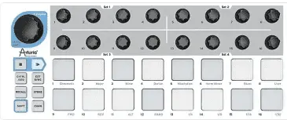
Existing Solutions
$99.99 BeatStep by Arturia
Type: Sequencer and Controller
Sequencer: 16 sequences, 16 steps each
I/O: USB Mini-B, ⅛” MIDI Out, ⅛“ CV out
Sounds: Requires Software
Effects: Requires Software
Power Source: USB Bus Powered
Speaker: None
Size: 0.6 x 12.8 x 5 Inches
Weight: 3 lbs
Notes:
Evan
https://www.sweetwater.com/store/detail/BeatStep--arturia-beatstep-pad-controller-and-cv-gate-sequencer
MAIN NOTES:
No built in sounds - requires software program or hardware midi connection to use
Requires power supply
Heavy
Large
No screen for GUI
No speaker
Type: Sequencer and Controller
Sequencer: 16 sequences, 16 steps each
Pads: 16 x velocity/pressure-sensitive backlit pads
Encoders/Pots: 16 assignable
MIDI I/O: Out (1/8" to 5-pin DIN adapter included)
USB: 1 x Mini-B
Other I/O: 1 x 1/8" CV out, 1 x 1/8" Gate out
Software: MIDI Control Center
Compatibility: Standalone, VST 2.4, VST3, RTAS, AAX, AU
OS Requirements - Mac: OS X 10.7 or later
OS Requirements - PC: Windows 7 or later
Power Supply: USB bus powered
Height: 0.6"
Width: 12.8"
Depth: 5"
Weight: 3 lbs.
Manufacturer Part Number: 430101

Slide 11
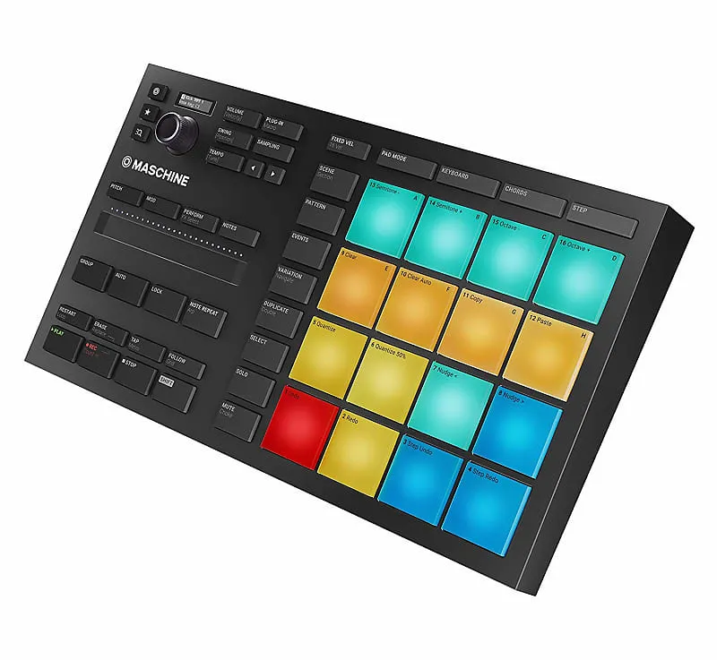
Existing Solutions
$269.99 Mikro MK3 by Native Instruments
Type: Pad Controller with Sequencer and Sampler
Sequencer: Step Sequencer, Realtime Recording Sequencing
I/O: USB-B, LCD screen
Sounds: Samples, one-shots, loops, instruments, drum kits, bass/drum synths
Effects: 33 total Effects (stutter, burst, reverb, compression,...)
Speaker: None
Power Source: USB bus powered
Size: 1.77 x 12.6 x 6.96 Inches
Weight: 2.47 lbs
Notes:
Evan
https://www.sweetwater.com/store/detail/MaschMik3--native-instruments-maschine-mikro-mk3-production-and-performance-system-with-software
MAIN NOTES:
Expensive
No speaker
Requires power supply
Has built-in sounds and additional sound libraries but requires software to load
Has LED and dial to navigate single sounds in library
Very heavy
Large
No speaker
Tech Specs
Type: Pad Controller with Sequencer and Sampler
Pads: 16 x Velocity-sensitive Performance Pads
Other Controllers: 1 x Dual-touch Smart Strip
Sounds: 1.6GB MASCHINE factory: samples, one-shots, loops, instruments, drum kits, bass/drum synths
Presets: Maschine factory patterns, songs
Sequencer: Step Sequencer, Realtime Recording Sequencing
Looper: Yes
Sampling: Yes, Vintage MPC60/SP1200 Sampling Emulation
Effects: 25 Studio FX: Filter, EQ, Delay, Reverb, Compression, and more ; 8 x Perform FX: Stutter, Burst Echo, Scratcher, Flanger
MIDI I/O: USB
USB: 1 x Type B
Storage: 3GB disk space (for Essentials plus MASCHINE Factory), 1GB disk space (for Massive, Monark, Reaktor Prism)
Format: VST, AU, Major DAW's, Standalone
Software: Massive, Monark, Reaktor Prism, MASCHINE Essentials
Compatibility: NKS Instruments/FX
OS Requirements - Mac: macOS 10.12 or later, Intel Core i5 processor or higher
OS Requirements - PC: Windows 10 or later, Intel Core i5 processor or higher
Power Source: USB bus powered
Height: 1.77"
Width: 12.6"
Depth: 6.96"
Weight: 2.47 lbs.
Manufacturer Part Number: 25707

Slide 12
Existing Solutions Recap
Sound Library Customizability
Sound Effects
Interactive UI
Mobility
Cost
1
Pocket Operator
$99.99
2
BeatStep
$99.99
3
Micro MK3
$269.99
Notes:
Evan

Slide 13
Project Vision
Display
4 Main Components
Display
Cabinet of sounds/effects
Measure Matrix
Play sounds/effects on steps
Palette
Easily accessible sounds/effects for transferring to measure
Directional-pad and other controls
Up, down, left, right select
Volume, save settings
Directional-pad and other controls
Measure Matrix
Palette
Notes:
Shawn
Inventory -> Palette?

Slide 14
Explanation of Display
Ability to assign a sound to the palette
If there is sound already assigned, would you like to replace it
MIDI sound or imported sound
If imported sound
Display list of imported sounds
Select desired sound
If MIDI sound
Display categories of instruments
Select instrument
Display list of specific sounds of instrument
Select desired sound
Ability to assign an effect to the palette
Display list of effects
Select desired effect
Additionally Displays:
Tempo
Volume
Imported Sounds BPM: 116 Vol: 10
Example 1
Example 2
Example 3 … continue
Notes:
Shawn

Slide 15
Specifications
Specification | Test Plan
Produce accurate and precise tempo down to smallest step to +/- 5% | Measure delay between steps and test against metronome timing for precision
Achieve four sounds layered at once | Mix minimum four sounds concurrently
High and low pass filters can be applied to final mixes | Output sounds with filters active and measure effect on output signal
Allow user interchangeable custom sound files | Play custom sound files from external storage
Preset and custom sounds can be mixed together | Output mixed preset and custom sounds
Notes:
Evan
Add to specification
High-pass lowpass fitlers
Volume adjustment
File structure naming convention for SD card “index#_soundname.mp3”
Invoke or not invoke sounds

Slide 16
Specifications Cont.
Specification | Test Plan
Graphical user interface can be used to navigate preset & custom sound libraries and saved pattern configs | Navigate sound libraries and saved configurations
BPM is adjustable through a user input | Cross check multiple BPM inputs with a metronome to confirm continuity
System outputs to wired or built-in speakers | Display system sound through headphones or speakers
System is operable by both rechargeable battery and power supply | Demonstrate system operation with and without external power supply
Notes:
Evan
Add to specification
High-pass lowpass fitlers
Volume adjustment
File structure naming convention for SD card “index#_soundname.mp3”
Invoke or not invoke sounds
Overlay multiple sounds on each beat in each measure
User can save loop settings created on device
User can recall sound loop settings created previously
Ability to adjust volume and clear sounds from beats

Slide 17
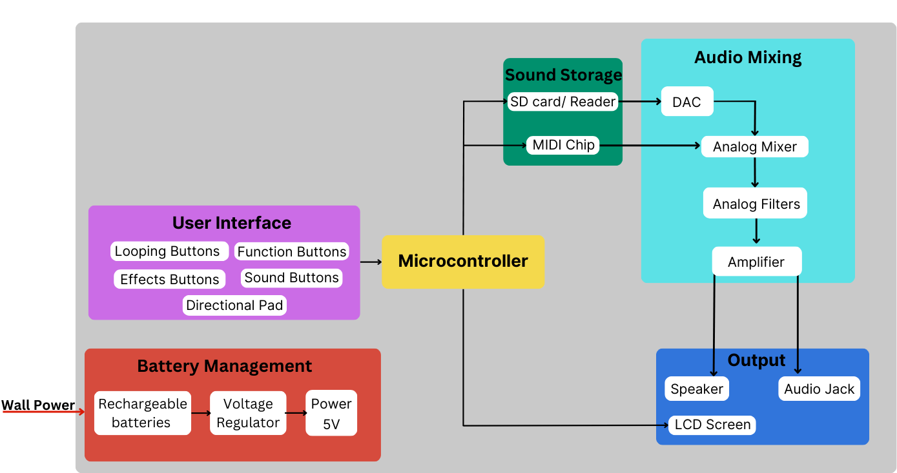
Hardware Block Diagram
Notes:
Ryan
Change color for microcontroller
Bigger font on lcd

Slide 18
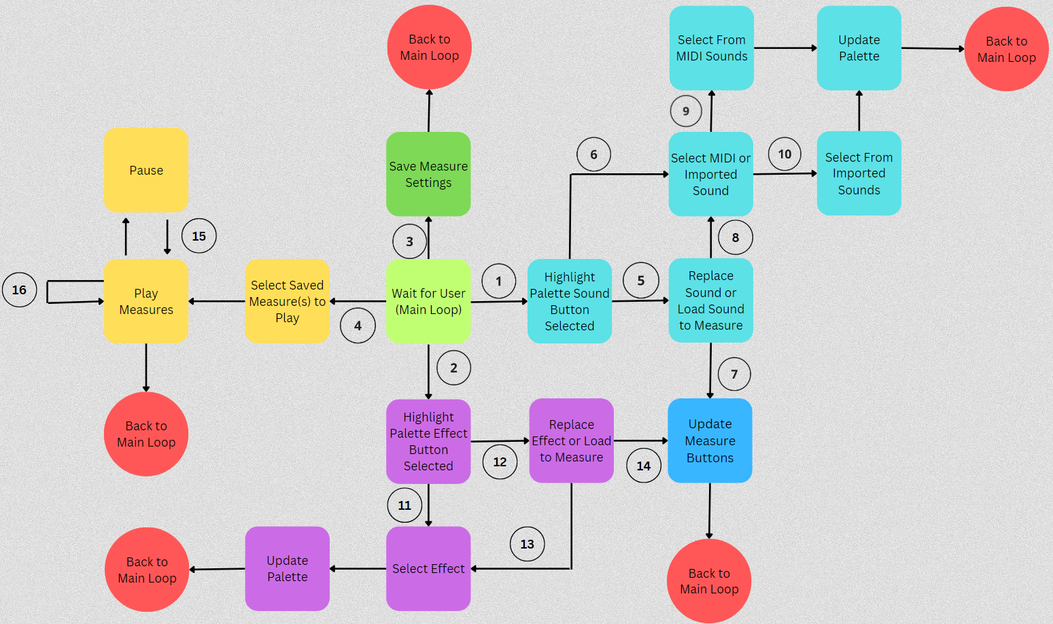
Software Block Diagram
Key
Palette sound button pressed
Palette effects button pressed
Save button pressed
Select measure button
If selected button memory already contains a sound
If button memory doesn’t contain a sound
Load sound to measure
Replace sound in palette
Select MIDI
Select imported
Button memory doesn’t contain an effect
Button memory does contain an effect
Replace effect in palette
Load effect to measure
Pause button is pressed
Measures loop once play button pressed until paused
Notes:
Shawn

Slide 19

PCB Requirements
Our board needs to be able to accommodate 40+ buttons, power input, audio output, a microcontroller, and multiple IC packages.
Inputs
40+ buttons for looping, sounds/effects, and functions
SD card reader to import user defined sounds/effects
Sound Manipulation
MIDI chip (VS1053b) for an onboard sound library
DAC chip to convert SD card sounds from digital to analog
Analog mixer for combining all of the sounds being played on each individual step
Analog filters to modulate the output
Output
Amplifier (LM386) to create stronger signal and allow for volume control
Headphone jack and speaker
LCD display for user interface with the device
Notes:
Ryan
Add VS1053b

Slide 20
MDR Deliverables
System built on breadboards & development boards
Audio sources implemented (MIDI & SD)
Preliminary display & user interface
Looping & palette buttons configured
Demonstrate one measure looping continuously
Ability to overlay one MIDI & one SD sound on each step
Effects overlay design
Analog mixing one MIDI & one SD sound
High pass & low pass filters designed, implemented
Battery management system designed
Notes:
Conor
Make more quantitative

Slide 21
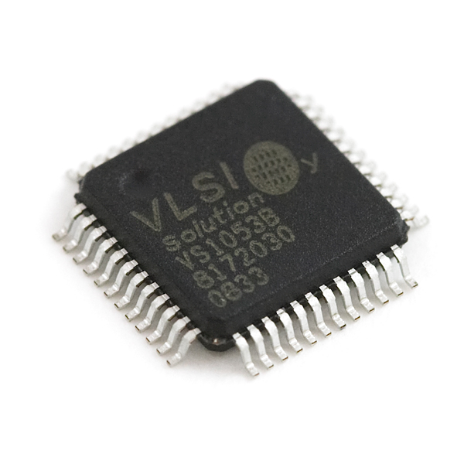
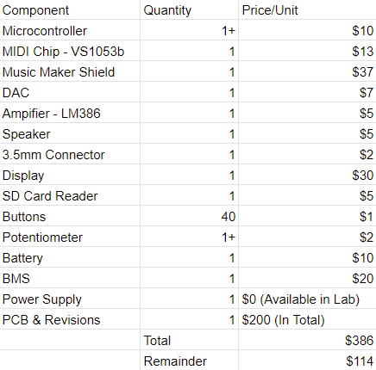
Cost of Components
Notes:
Conor
Add battery!

Slide 22
Member Responsibilities
Evan Rovelli (CompE)
Software Lead, Software UI, Power Management, Display Interface, Storage
Ryan Gordon (EE)
PCB Lead, PCB Design in Altium, Hardware UI, Audio Output
Shawn Colby (CompE)
Timing and Looping Lead, Metronome Timing, Sounds & Effects, Power Management
Conor Curtin (CompE)
Team Coordinator, Budget Lead, MIDI, Audio Output, Display Interface
Notes:
Conor

Slide 23
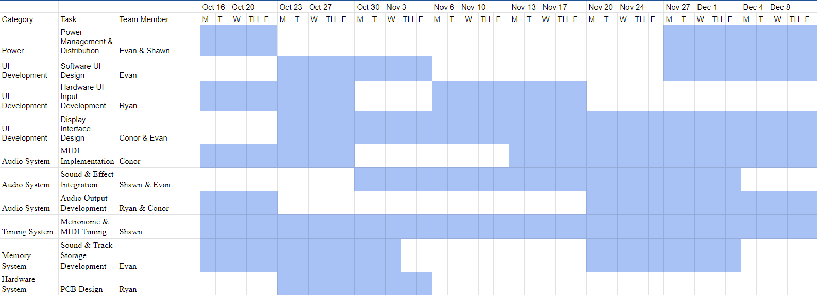
Gantt Chart
Notes:
Conor

Slide 24
Questions?

Slide 25
Sources
Images:https://www.polycase.com/techtalk/potting-boxes/pcb-potting.html
https://macprovideo.com/article/audio-hardware/11-hardware-midi-sequencers-every-producer-should-consider
https://www.sparkfun.com/products/retired/8892
Pocket Operator KO!: https://teenage.engineering/guides/po-33/en
BeatStep https://www.sweetwater.com/store/detail/BeatStep--arturia-beatstep-pad-controller-and-cv-gate-sequencer
Mikro MK3 https://www.sweetwater.com/store/detail/MaschMik3--native-instruments-maschine-mikro-mk3-production-and-performance-system-with-software

